Slide 1
What is g-loading and how to calculate it?
Psychometric Conference 2015
Ou Zhang

Slide 2
What is g Factor?
The g factor (short for "general factor") is a construct developed in psychometric investigations of cognitive abilities.
It is a variable that summarizes positive correlations among different cognitive tasks, reflecting the fact that an individual's performance at one type of cognitive task tends to be comparable to his or her performance at other kinds of cognitive tasks.
Presentation Title runs here l 00/00/00

Slide 3
What is g Factor? (cont.)
The existence of the g factor was originally proposed by Charles Spearman.
He observed that children's performance ratings across seemingly unrelated school subjects were positively correlated, and reasoned that these correlations reflected the influence of an underlying general mental ability that entered into performance on all kinds of mental tests.
Spearman suggested that all mental performance could be conceptualized in terms of a single general ability factor, which he labeled g, and a large number of narrow task-specific ability factors.
Presentation Title runs here l 00/00/00

Slide 4
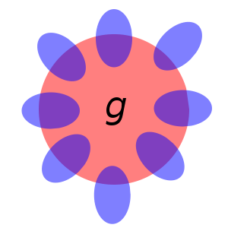
What is g Factor? (cont.)
Each small oval is a hypothetical mental test.
The blue areas correspond to test-specific variance (s), while the purple areas represent the variance attributed to g (Spearman's two-factor intelligence theory).
Presentation Title runs here l 00/00/00

Slide 5
Why g Factor is important to our work?
IQs are indicators of psychometric g, the hypothetical source of individual differences across all cognitive tasks.
Carroll (1993) demonstrated consistent evidence for least three levels of cognitive abilities that vary according to their generality (Schneider & McGrew, 2012).
Presentation Title runs here l 00/00/00

Slide 6
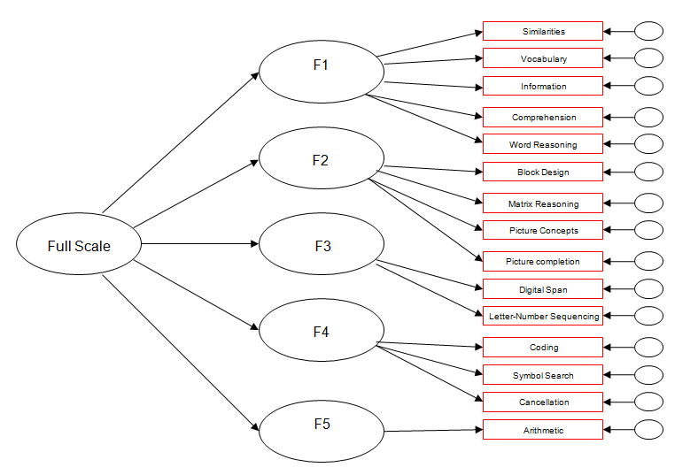
Why g Factor is important to our work? (cont.)
Narrowly focused abilities associated with small subsets of cognitive tasks (e.g., requiring provision of word meanings or completion of pictorial analogies) compose stratum I (Schneider & McGrew, 2012).
Presentation Title runs here l 00/00/00

Slide 7

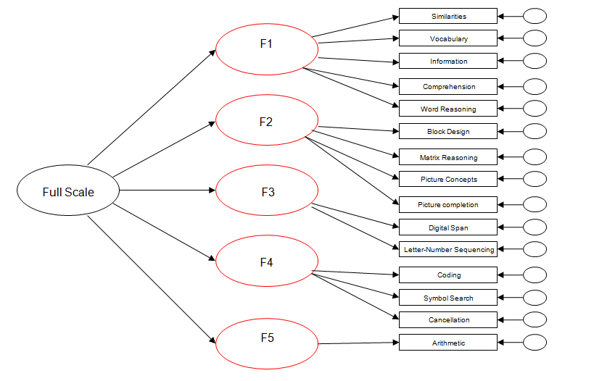
Why g Factor is important to our work? (cont.)
Abilities associated with broad categories of task content (e.g., verbal content and visual content) or cognitive processes (e.g., reasoning processes and short-term memory processes) compose stratum II
Presentation Title runs here l 00/00/00

Slide 8
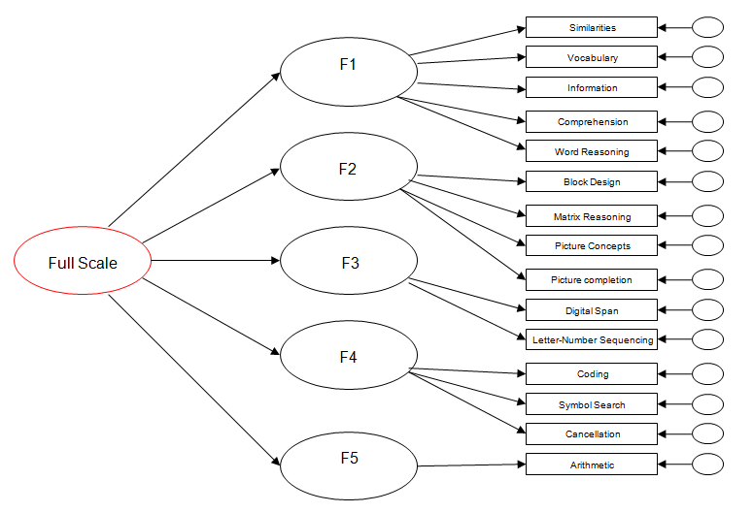
Why g Factor is important to our work? (cont.)
Psychometric g is positioned at the apical and most general level, stratum III.
Presentation Title runs here l 00/00/00

Slide 9
What is the possible range of g Factor ?
The effect of psychometric g on any variable can be measured as a g loading, a standardized coefficient with a hypothetical range from .00 (indicating no relation) to 1.00 (indicating a perfect relation).
g ~ (0.00 – 1.00)
Interpretation guidelines indicate that g loadings of .70 or higher can be considered strong (Floyd, McGrew, Barry, Rafael, & Rogers, 2009; McGrew & Flanagan, 1998).
Presentation Title runs here l 00/00/00

Slide 10

How to calculate g Factor ?
Spearman (1927) proposed an estimate that was supposed to represent the g loading of the global composite.
More recently, model-based estimates calculated from structure equation models have been proposed (e.g., McDonald, 1999). It is referred as coefficient Omega ( ), or omega squared.
Omega is a general estimate and may be used to determine the saturation of one factor (e.g., g) in a composite even when there are multiple factors (e.g., g and group factors) contributing to the composite, and it may also be used to calculate the saturation of all of the factors contributing to the composite.
Presentation Title runs here l 00/00/00

Slide 11


How to calculate g Factor ? (cont.)
There are two types of Omega coefficients:
First, the hierarchical omega- was calculated as the square of the sum of subtest g loadings divided by the total variance in the subtest scores included in the composite (Gustafsson, 2002). This estimate represented the proportion of variance in the global composite that was accounted for by g.
Second, estimates were calculated; these estimates were based on all of the common factors in the nested factor model, including g and the other first-order group factors. The sum of subtest g loadings squared, and the sum of each group’s factor subtest loadings squared, were summed and divided by the total variance in the subtest scores.
Presentation Title runs here l 00/00/00

Slide 12
How to calculate g Factor ? (cont.)
The square root of represented the correlation between the composite score and latent g, which is the g loading for the composite (McDonald, 1999).
EFA: One way to find is to do a factor analysis of the original data set, rotate the factors obliquely, factor that correlation matrix, do a Schmid-Leiman transformation to find general factor loadings, and then find .
CFA 1: In a hierarchical factor model, the g factor is modeled as a first-order factor with direct effects on every subtest.
CFA 2: In a higher-order factor model, the g factor is modeled as a higher-order factor (apex) with indirect effects via first-order factor on every subtest.
Presentation Title runs here l 00/00/00

Slide 13
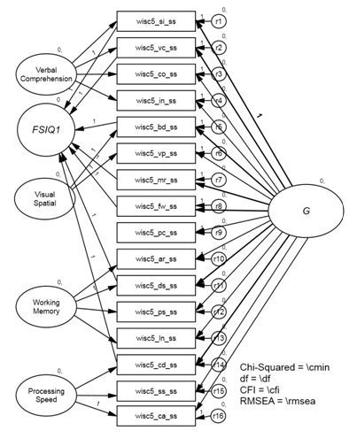
How to calculate g Factor ? (cont.)
Hierarchical factor model :
Presentation Title runs here l 00/00/00

Slide 14
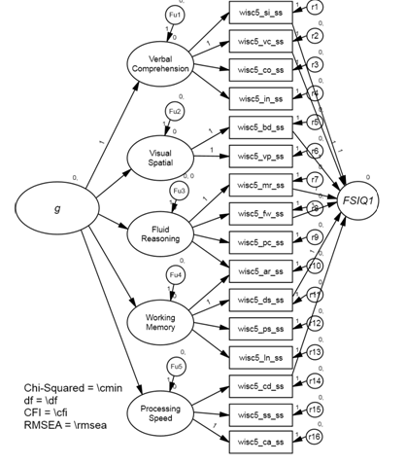
How to calculate g Factor ? (cont.)
Higher-order factor model:
Presentation Title runs here l 00/00/00

Slide 15
How to calculate g Factor ? (cont.)
The g-loading in the higher-order factor model is theoretically lower than the g-loading in the hierarchical factor model.
Although the higher-order factor model and hierarchical factor model are just near equivalent, the higher-order factor model has more constraints than hierarchical factor model.
Presentation Title runs here l 00/00/00

Slide 16
g Factor-WISC5 FSIQ Example
FSIQ1: 7 subtests, SI VC BD MR FW DS CD
  (2 verbal comprehension, 1 visual spatial, 2 fluid reasoning, 1 working memory, 1 processing speed)
FSIQ2: 8 subtests, SI VC BD VP MR FW DS CD
  (2 verbal comprehension, 2 visual spatial, 2 fluid reasoning, 1 working memory, 1 processing speed)
FSIQ3: SI VC BD VP MR FW DS PS CD SS
  (2 verbal comprehension, 2 visual spatial, 2 fluid reasoning, 2 working memory, 2 processing speed)
FSIQ4 (WISC4 reconstructed; not a current consideration but only for comparison sake): SI VC CO BD MR PC DS LN CD SS
  (3 verbal, 1 visual spatial, 2 fluid reasoning, 2 working memory, 2 processing speed)
Presentation Title runs here l 00/00/00

Slide 17
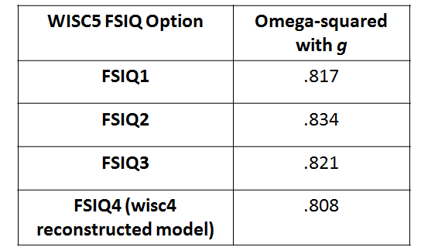
g Factor-WISC5 FSIQ Example
Omega-squared
Presentation Title runs here l 00/00/00

Slide 18
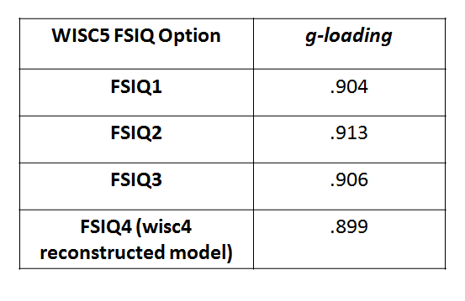
g Factor-WISC5 FSIQ Example
g-loading:
Presentation Title runs here l 00/00/00

Slide 19
g Factor-WISC5 FSIQ Example
g-loading:
g loadings of .70 or higher can be considered strong
Presentation Title runs here l 00/00/00

Slide 20
g Factor-WISC5 FSIQ Example
g-loading:
✓
✓
✓
✓
g loadings of .70 or higher can be considered strong
Presentation Title runs here l 00/00/00

Slide 21
Thank you

